Slide 1
Guided Tour to TensorFlow: Large-scale Machine Learning system
Seehwan Yoo
Dankook University

Slide 2
TensorFlow: graph execution system
Graph processing
Edge/tensor: data
Node/kernel: operation on data
Why tensorflow?
Based on large-scale data processing model (map-reduce, google file system), Google built data manipulation system on matrix data
Good
Easy to handle large data
Easy to expand to multiple computers
Quick to process large amount of data
Distributed data processing model

Slide 3
TensorFlow – Build / Install
TensorFlow recommendation – Inside the container, use pip
Good
Easy install / use
If you’re eager to execute
Bad
You cannot modify the source code
If you want something more for TF, you should make your hands dirty

Slide 4
Goal of this time
Introduce TF source tree
Where you can find which functions
Tensor, Graph, OpKernel implementation-level
Gently guide you to travel with TF
HelloWorld with TF
Bazel tool – popular for any google sw products
Python support is important – popular for any sw developers
Some possible future directions
Security extension (security-guarded TensorFlow)
Parallel execution on CPU/GPU/compute-devices

Slide 5
TensorFlow Build
Follow the source build tutorial
If you’re using Tf. w/ GPU, get CUDA and related libraries ready
Git clone configure / bazel build
Bazel is java-based multi-language sw build tool
Tf mainly uses c++, but there are python, go, java interfaces
Most recent google software uses bazel build
Make pip wheel, install it
Usually takes some hours
While it is being compiled, let’s see some code work, done by google
about 9k sub modules exist

Slide 6
Inside Tensorflow, Directory Structure
tensorflow
Main code repository, many directories
Core (some file names)
Common_runtime (copy_tensor.cc, device.cc, direct_session.cc, executor.cc, function.cc, graph_execution_state.cc, graph_runner.cc, placer.cc, process_state.cc, threadpool_device.cc, etc.)
Framework (device_base, function.cc, kernel_dev_builder.cc, load_library.cc, op.cc, op_kernel.cc, tensor.cc,
Graph (algorithm.cc, graph.cc, graph_constructor.cc, graph_def_builder.cc, grph_partition.cc, node_builder.cc, tensor_id.cc,
Kernels 1000+ kernels, *.cc files 864 (matmul.cc, 10 matmul functions – mkl_matmul_op.cc,
Platform
Examples
Stream_executor
And some of language interfaces (c, cc, python, java, js, lite, etc.)

Slide 7
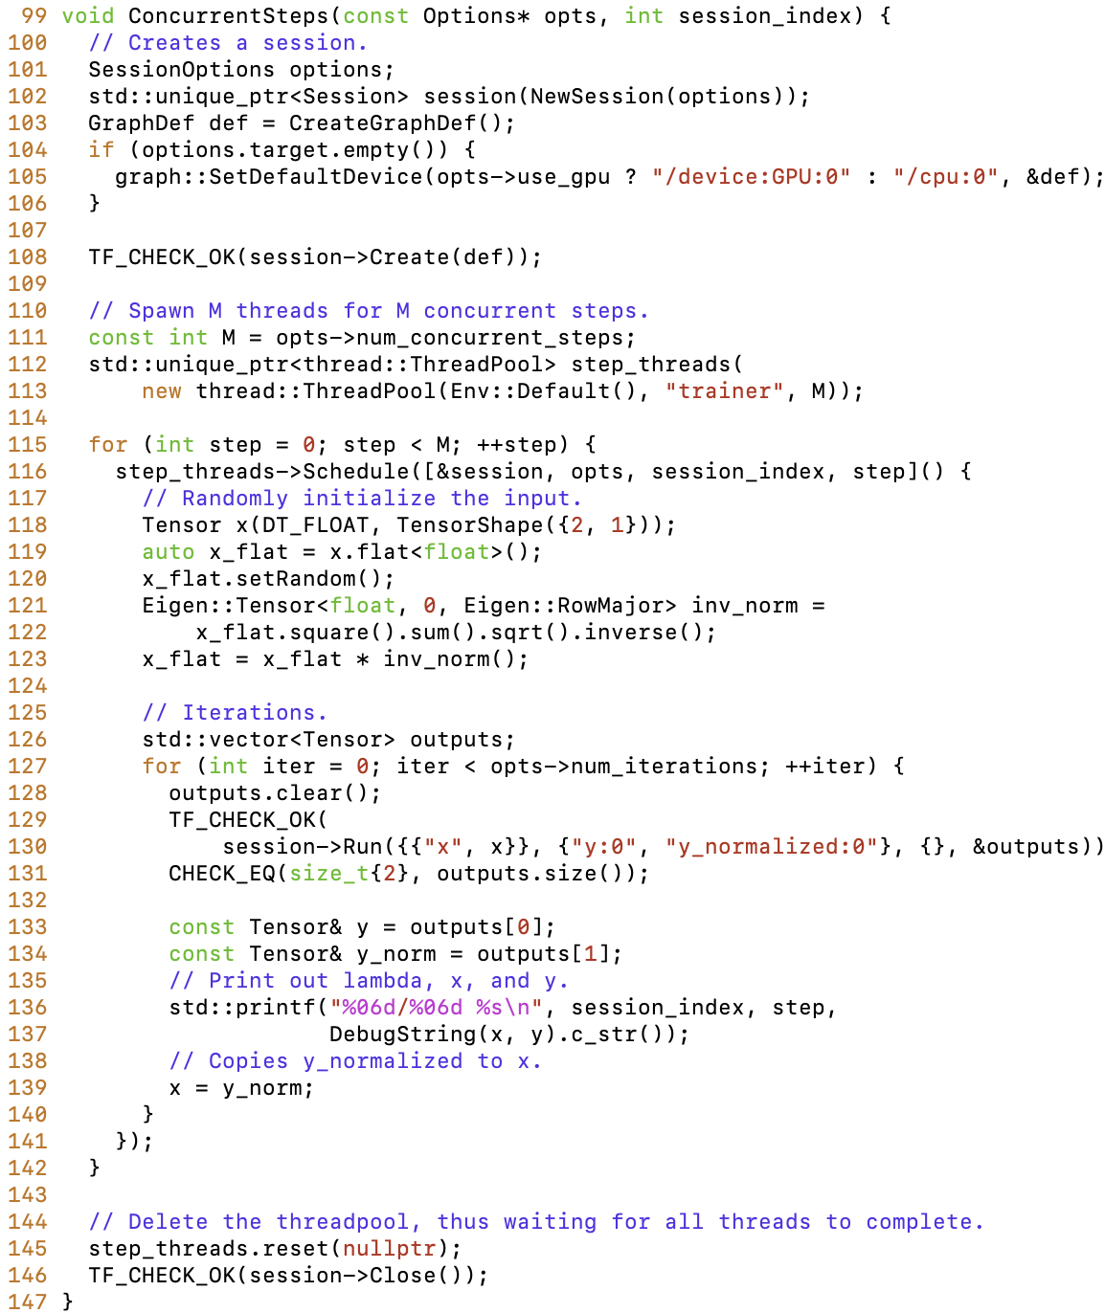
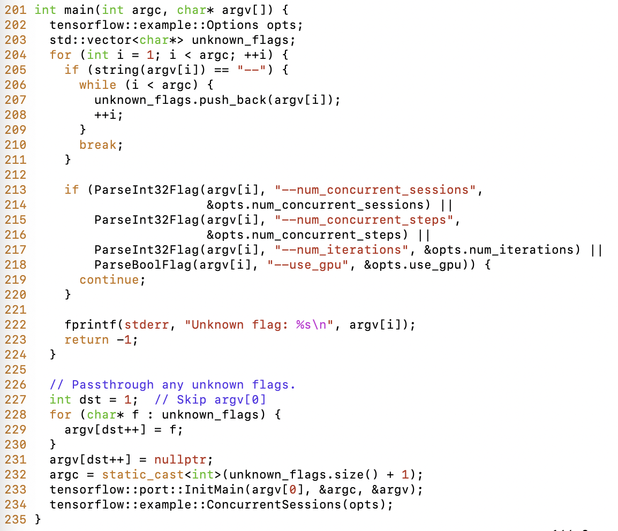
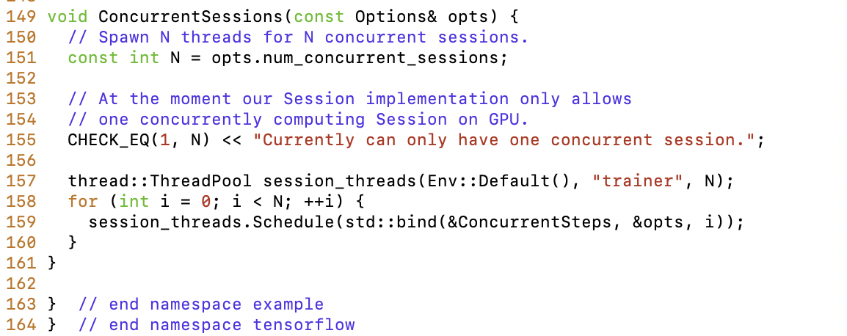
TensorFlow C++, slightly longer than Python
cc/tutorials/example_trainer.cc

Slide 8
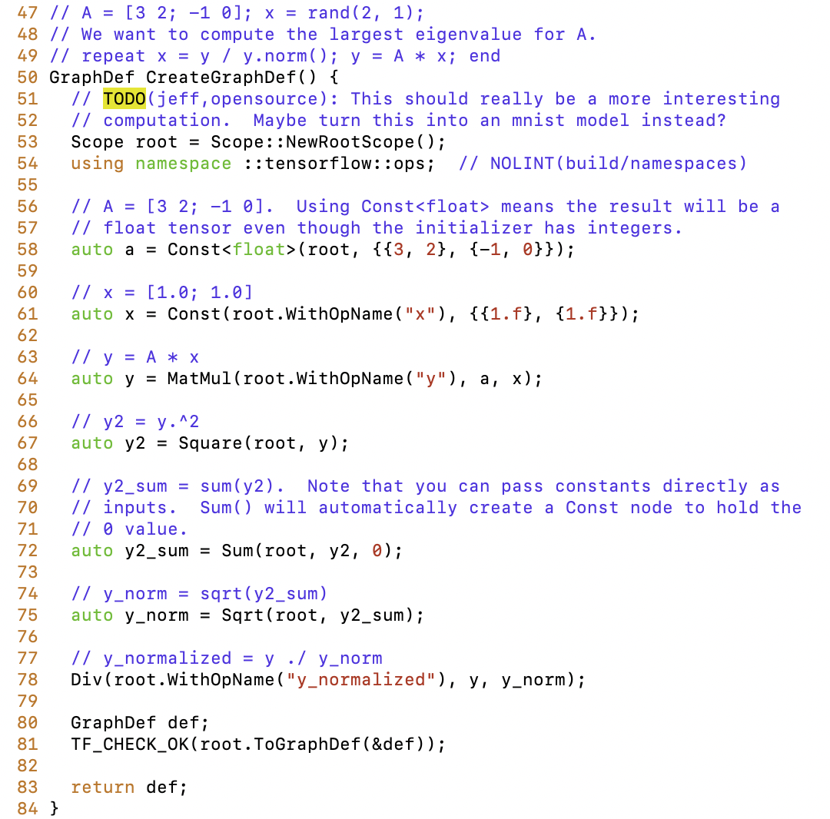
TensorFlow C++, graph build
Similar to Python
Root.ToGraphDef() makes GraphDef structure
Where is Tensor?
Where is OpKernel?

Slide 9
TensorFlow C++, concurrent execution
ConcurrentSessions()
Makes ThreadPool objs
ThreadPool::Schedule() make threads ready & execute when ready
Threads are bound with ConcurrentSteps
With GraphDef obj, SetDefaultDevice
Initialize input tensor (random)
session->Run()
Observe Tensors

Slide 10
TensorFlow Python
13 xy = np.loadtxt('03train.txt', unpack=True, dtype='float32')
14 x_data = xy[:-1]
15 y_data = xy[-1]
16
17 # 5행 4열로 구성된 파일이지만, numpy에서 읽어오면 4행 5열이 된다.
18 # 그래야 열 단위로 행렬 연산을 수행할 수 있다.
19 print(type(xy)) # <class 'numpy.ndarray'>
20 print(xy.shape) # (4, 5)
21 print(len(x_data)) # 3
22
23 # W는 1x(x_data 크기) 매트릭스
24 with tf.device('/cpu:0'):
25 W = tf.Variable(tf.random_uniform([1, len(x_data)], -1, 1))
26
27 hypothesis = tf.matmul(W, x_data)
28
29 cost = tf.reduce_mean(tf.square(hypothesis - y_data))
30
31 rate = tf.Variable(0.1) # learning rate, alpha
32 optimizer = tf.train.GradientDescentOptimizer(rate)
33 train = optimizer.minimize(cost) # goal is minimize cost
34
35 init = tf.initialize_all_variables()
36
37 sess = tf.Session()
38 sess.run(init)
39
40 for step in range(2001):
41
42 sess.run(train)
43
44 if step % 20 == 0:
45 print(step, sess.run(cost), sess.run(W))
46
47 sess.close()
sess = tf.Session()
sess.run(train)
train = optimizer.minimize(cost)
optimizer=tf.train.GradientDescentOpti- mizer(rate)
rate=tf.Variable(0.1)
cost = tf.reduce_mean(tf.square (hypothesis – y_data))
hypothesis = tf.matmul(W,x_data)
W = tf.Variable(tf.random_uniform( [1, lex(x_data)], -1, 1))

Slide 11
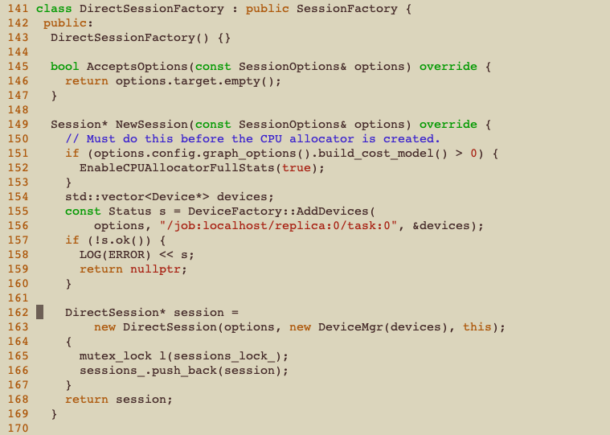
Session – The beginning point of the travel
core/common_runtime/direct_session.cc
Inside NewSession(),
DeviceFactory::AddDevices (&devices)
Obtain devices vector
session = new DirectSession(… new DeviceMgr(devices) , ...);
Make session object
Associate devices vector with DeviceMgr

Slide 12
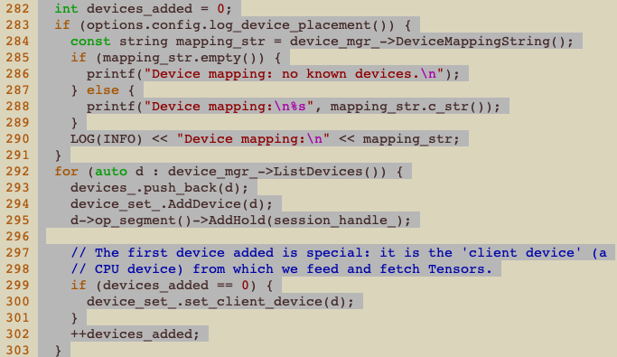
DirectSession
Sets up environment, including devices set
with tf.devices (“cpu:0”):
core/common_runtime/ direct_session.cc
Constructor →
device_set_.AddDevice();
// add avail. devices
First device is client device (CPU)

Slide 13
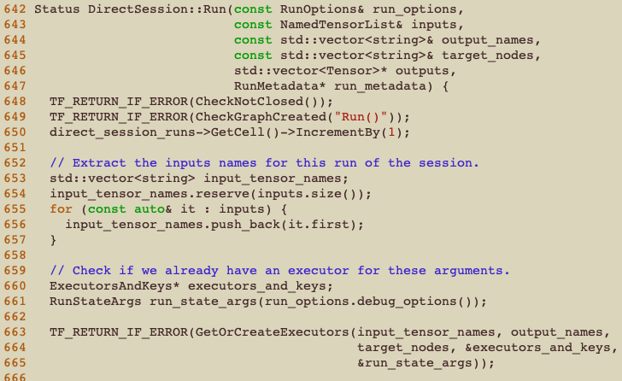
DirectSession::Run()
calls Run() with more params →
inputs: NamedTensorList
Prepare for running the session
GetOrCreateExecutors
There are executors

Slide 14
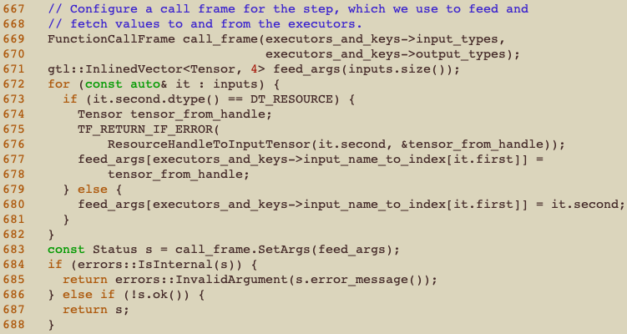
DirectSession::Run() cont’
Set up a call frame
Meet the Tensor!
For-each inputs,
Tensor tensor_from_handle
ResourceHandleTo- InputTensor();
Set up feed_args InlinedVector <Tensor, 4>
call_frame.setArgs

Slide 15
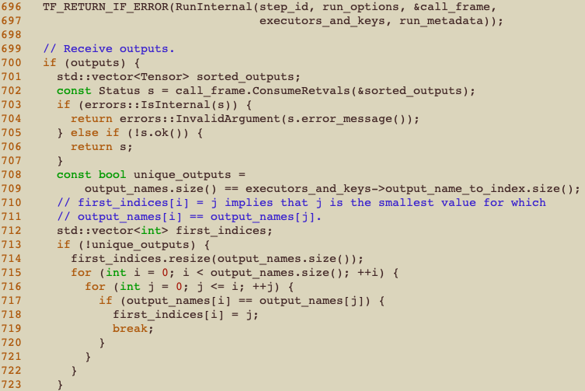
DirectSession::Run() cont’
RunInternal();
Run the executors
Output is on the call_frame
call_frame. ConsumeRetvals (sorted_outputs)
Obtain outputs
…
Fill in outputs var

Slide 16
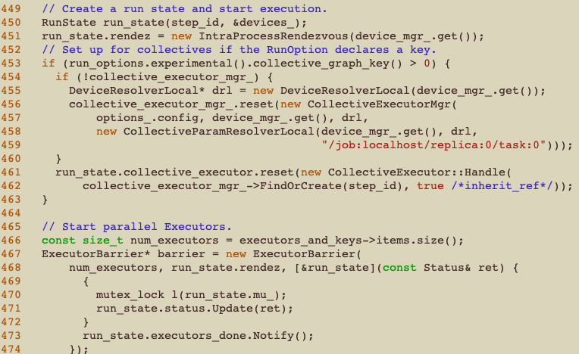
DirectSession::RunInternal()
Internal session run routine
run_state holds execution state
Reset before execute
ExecutorBarrier
Has lambda argument
run_state. executors_done. Notify();

Slide 17
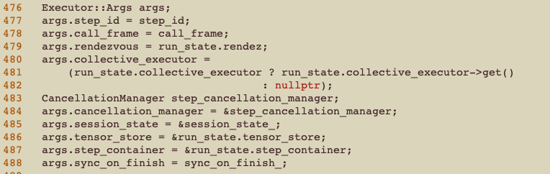
DirectSession::RunInternal() cont’`
Sets up executor args
Set up some important fields
call_frame, rendezvous, collective_executor, tensor_store, sync_on_finish, etc.

Slide 18
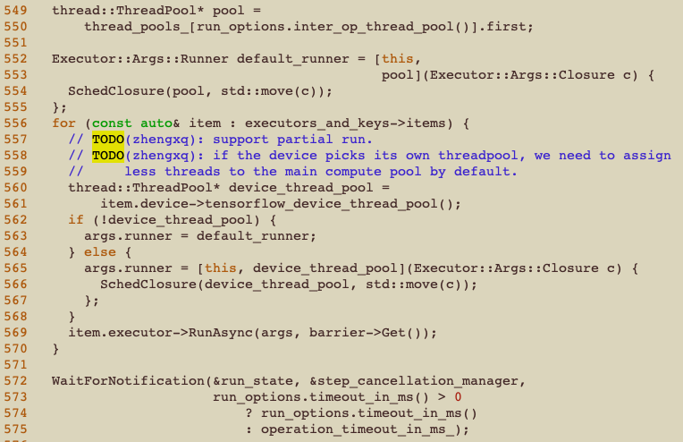
DirectSession::RunInternal() cont’
Executor::Args::Runner
default_runner is an obj
args.runner is lambda
Item.executor ->RunAsync()

Slide 19
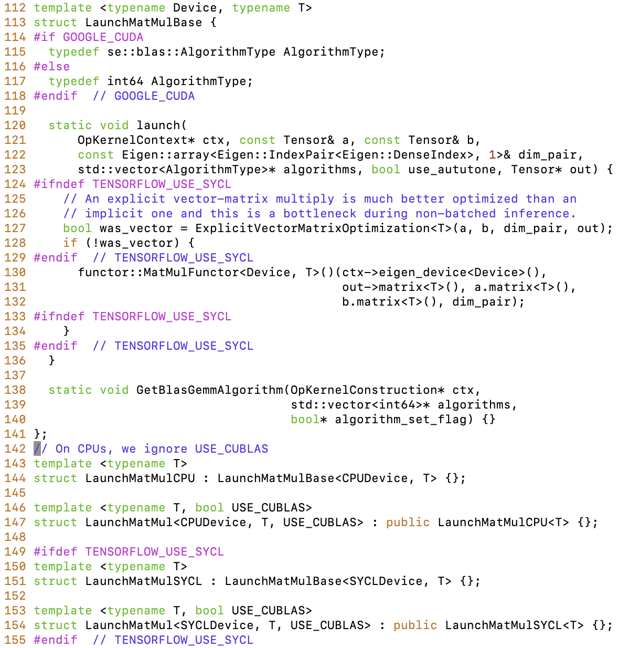
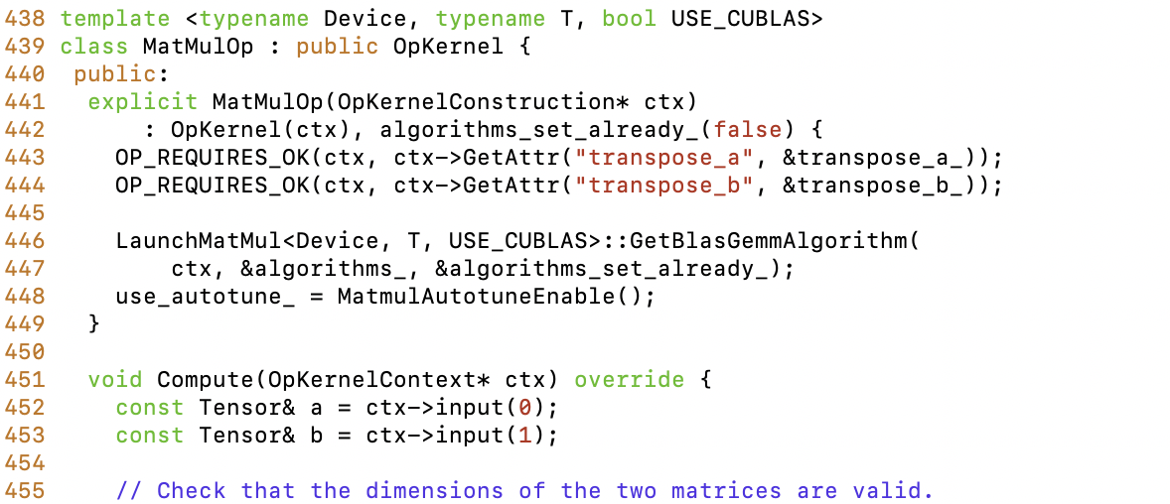
OpKernel
An example) MatMul is an OpKernel
Matrix multiply
optimized math library for GPU, Intel avx, (MKL)
core/kernels/matmul_op.cc
Uses Functor, lambda objs, Templates

Slide 20
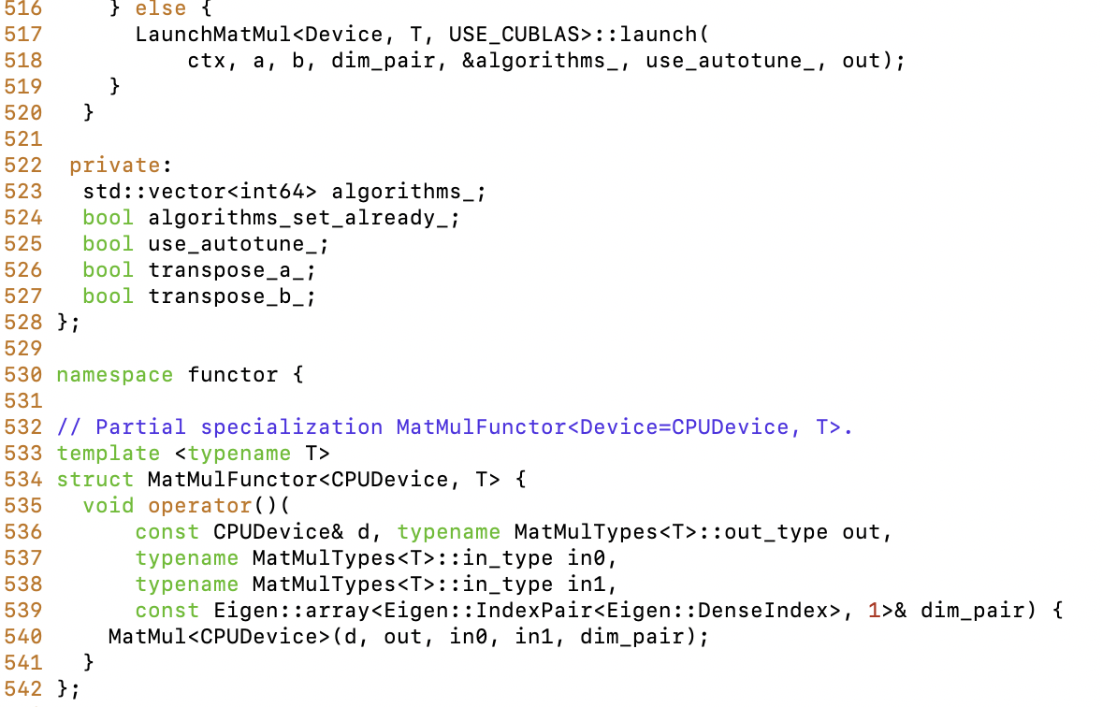
MatMul OpKernel
An example) MatMul is an OpKernel
Matrix multiply
optimized math library for GPU, Intel avx, (MKL)
core/kernels/matmul_op.cc
Uses Functor, lambda objs, Templates

Slide 21
Goal of this time
Introduce TF source tree
Where you can find which functions
Tensor, Graph, OpKernel implementation-level
Gently guide you to travel with TF
HelloWorld with TF
Bazel tool – popular for any google sw products
Python support is important – popular for any sw developers
Some possible future directions
Security extension (security-guarded TensorFlow)
Parallel execution on CPU/GPU/compute-devices

Slide 22
What I do after writing code..
Open chrome ‘tensorflow build from source’
bazel build --config=opt --config=cuda //tensorflow/tools/pip_package:build_pip_package
./bazel-bin/tensorflow/tools/pip_package/build_pip_package ~/tmp # create package
pip install ~/tmp/tensorflow-version-tags.whl --force-reinstall
Test with my python script
Test print out from session initialization code e.g.) enumerate all the devices, tensor names

Slide 23
Python support is important
TensorFlow is evolving software, and many people are contributing code
And much more users!
Let others do as before
Keep the language interface same as much as before

Slide 24
Goal of this time
Introduce TF source tree
Where you can find which functions
Tensor, Graph, OpKernel implementation-level
Gently guide you to travel with TF
HelloWorld with TF
Bazel tool – popular for any google sw products
Python support is important – popular for any sw developers
Some possible future directions
Security extension (security-guarded TensorFlow)
Parallel execution on CPU/GPU/compute-devices

Slide 25
Security extension
Let me assume some data (Tensors) have much private information, than the others
First layer raw input images (human faces in photos, medical data)
Integrity of original learning data is important
You want to be secure from adversarial attacks
Some OpKernels are more important than the others
Initial random Tensor, First several layers
Then, we can move out some part of execution to secure execution environment
Such as SGX, TrustZone, NestedKernel, TEE

Slide 26
Some approaches
Software only protection
Differential privacy protection
Add some random noise (yet, the result should be ‘almost’ same)
Relax privacy concern from overly accurate private data
Hardware protection
Put all the code in TCB is impossible
Hypervisor / Virtual machines & Containers & TrustZone
Application-level separation (compiler-support)
SGX has physical limitation (about ~92MB)
They are hard to work with TensorFlow
Can you put some tensor/kernel out of TensorFlow?
And Place them on SGX enclave?

Slide 27
Why not? Secure-TensorFlow
Place raw data within SGX enclave – not exposed at run-time
Place first layers processing – not exposed to the others
How?
Label the tensor, OpKernel that it is secure processing
Once TF sees, move it out, and send it on SGX enclave
SGX enclave runs a server that takes input tensor and kernel
Run within enclave
What’s good?
It can work with GPU; whereas not others with SGX
It can work with software privacy; orthogonally integrate-able

Slide 28
Parallel execution with HCA
HCA (Heterogeneous Computing Architecture)
GPU, CPU, Manycore, FPGA, etc.
Work (collaborate) with each other
Monitoring tool is essential
Not available for tensorflow
People says ‘hyper-parameter tuning is essential’
How efficiently TF utilizes GPUs?
More accurate monitoring is required
How about FPGA/TPU? How about Manycore?
What could be the best visualization of different compute devices utilization?
Should be better than nvidia-smi

Slide 29
Summary
TensorFlow with Gentle introduction to source tree
Session, Tensor, OpKernel
I am writing secure-TF,
moving out of private tensor, kernel from Tensorflow framework
Use GRPC for moving out tensor, kernel operations
Use asylo for leveraging SGX
After writing code
Running bazel (build system)
Test with python script
Some possible future work
Security, heterogeneous computing

